Slide 1

ROCKY MOUNTAIN FOREST DISTRICT
MOUNTAIN PINE BEETLE UPDATE
February 1st, 2009

Slide 2
Outline
Mountain Pine Beetle Management
TSA Infestation Levels
Timber Supply Mortality Impacts
Single Tree Treatment Program
Forest Health NRFL
Stand Development Monitoring

Slide 3

PROVINCIAL AERIAL OVERVIEW 2009
DRM MPB INFESTATION
51,645 HA

Slide 5
Cranbrook TSA’s Most
Heavily Impacted Landscape Units
LU # | LOCATION | INFESTED HA | PORTION OPERABLE | COMMENTS
4 | Hellroaring | 3,988 | 49% | Terrain and Caribou Constraints
2 | Perry Ck | 2,704 | 68% | ECA and Terrain Constraints
5 | Redding Ck | 2,296 | 17% | Terrain constraints
8 | Kimberley Watershed | 2,082 | 76% | Terrain Constraints and planning issues
–

Slide 7
Invermere TSA’s Most
Heavily Impacted Landscape Units
LU # | LOCATION | INFESTED HA | PORTION OPERABLE | COMMENTS
23 | Cross River | 2,561 | 32% | Terrain and wood quality constraints
3 | Skook-Torrent | 1,906 | 75% | Terrain constraints
12 | Doctor-Fir | 1,788 | 62% | Terrain constraints
21 | Albert River | 1,710 | 70% | Terrain constraints
–

Slide 8
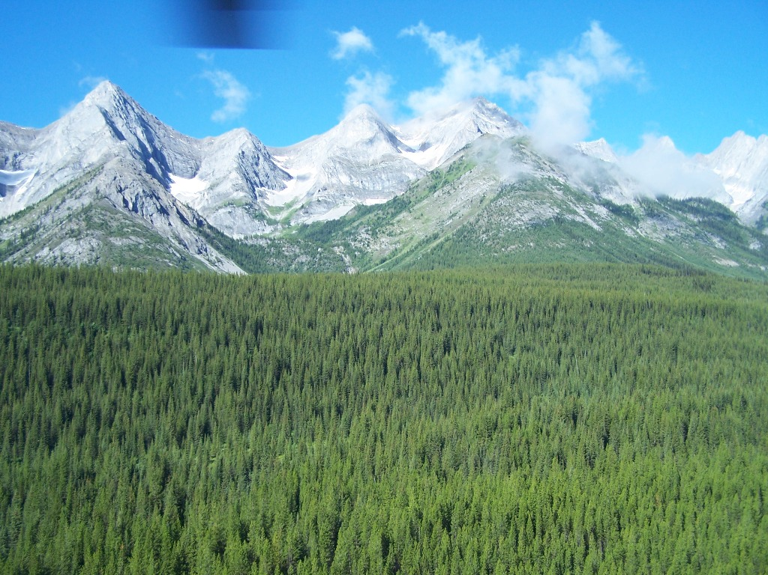
Pine Stands in upper Elk Valley south of the Alberta/BC border
October 2009

Slide 9
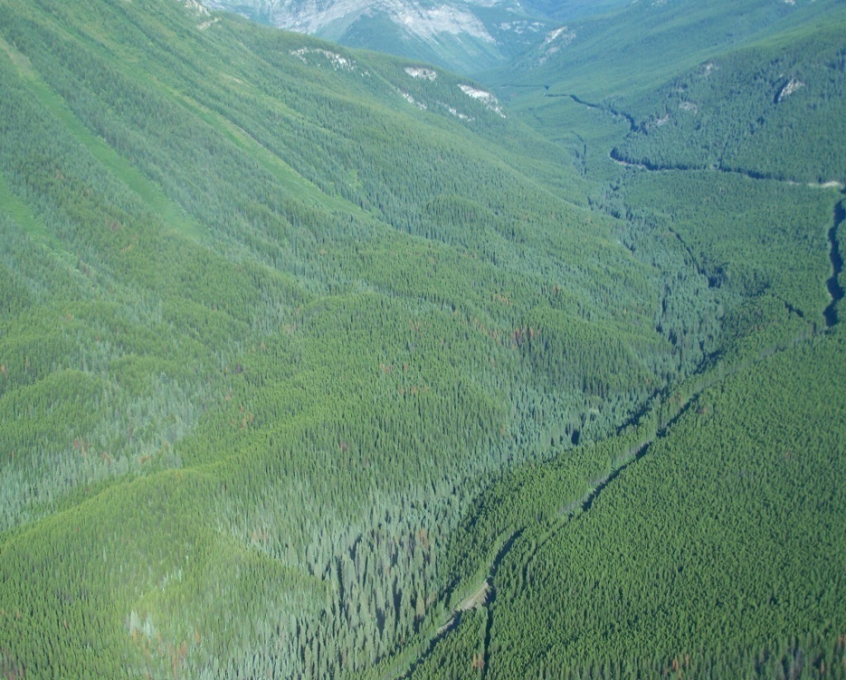
Forsyth Creek – Elk Valley
Single Tree Treatment Sites 2009/10

Slide 10

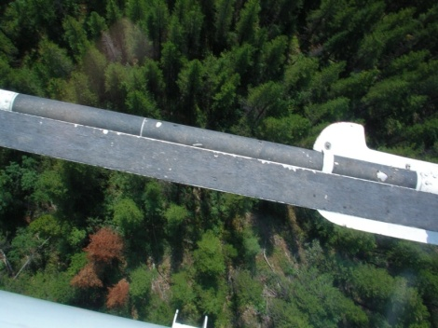
SINGLE TREE TREATMENT PROGRAM
SUPPRESSION UNIT FUNDING RECEIVED
$766,000 FIA
$1.4 Million Federal Funds
(only District in the Province funded in 2009)
ACTIVITES PLANNED
GPS Detailed Aerial Survey
20,000 Ha Ground Surveys to mark infested stems
12,000 Fall and Burn

Slide 11
SINGLE TREE TREATMENT PROGRAM
SUPPRESSION BEETLE MANAGMENT UNITS
LOCATION | LANDSCAPE UNIT (Green font indicates Federally Funded)
CBK TSA | C01, C09, C10, C11, C12, C14, C15, C16, C17, C18, C19, C20, C21, C22, C22, C38
INV TSA | I06, I07, I08, I09
TFL 14 | I34, I35, I37, I38

Slide 12
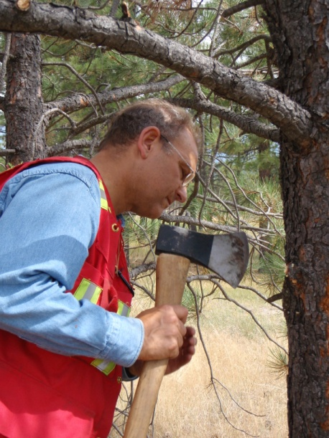
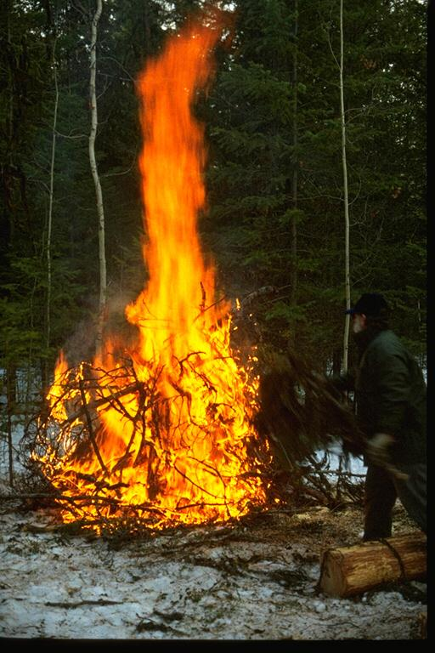
SINGLE TREE TREATMENT PROGRAM
ACCOMPLISHMENTS TO DATE
LOCATION | GPS AERIAL SURVEY POINTS | GROUND SURVEY HA | FALL AND BURN TREES
Cranbrook TSA | 4,096 | 6,500 | 850
Invermere TSA | 2,108 | 2,500 | 300
TFL 14 | 788 | 1,200 | 3,000
TOTAL | 6,992 | 10,200 | 4,150

Slide 13
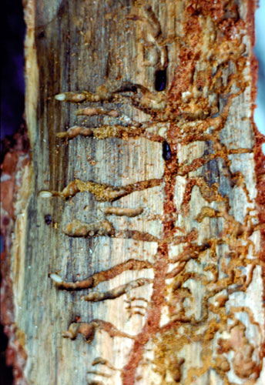
POPULATION TRENDS
Unsettled conditions with variable
Green to Red Ratios – range 0.5 : 1 to 3:1
Local populations are down slightly overall from last year
Anomalies exist in some locales suggesting transient influx (from Montana)
Overwinter mortality surveys will be conducted in late March

Slide 14
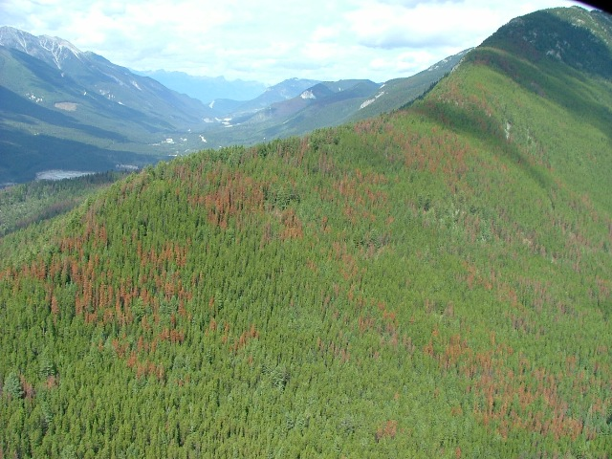
FOREST HEALTH NRFL
CBK TSA
100,000 m³ targeting MPB infested and highly susceptible lodgepole pine to be advertised shortly
Shorter term (3yr.) to address reducing spread rate

